Slide 1
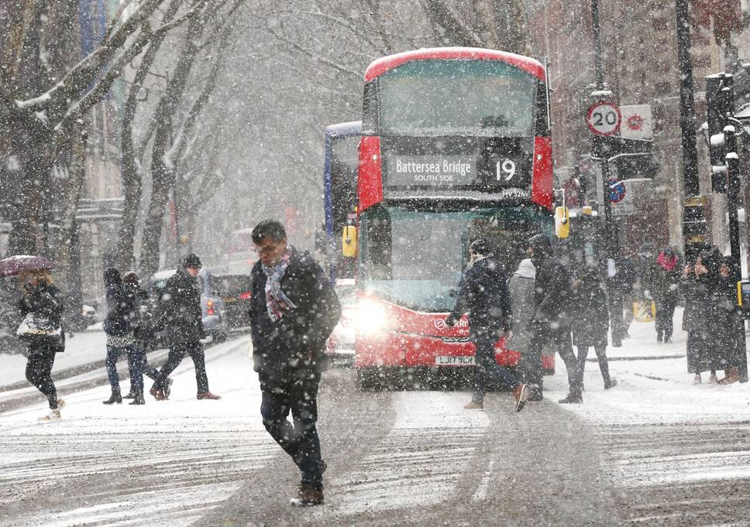
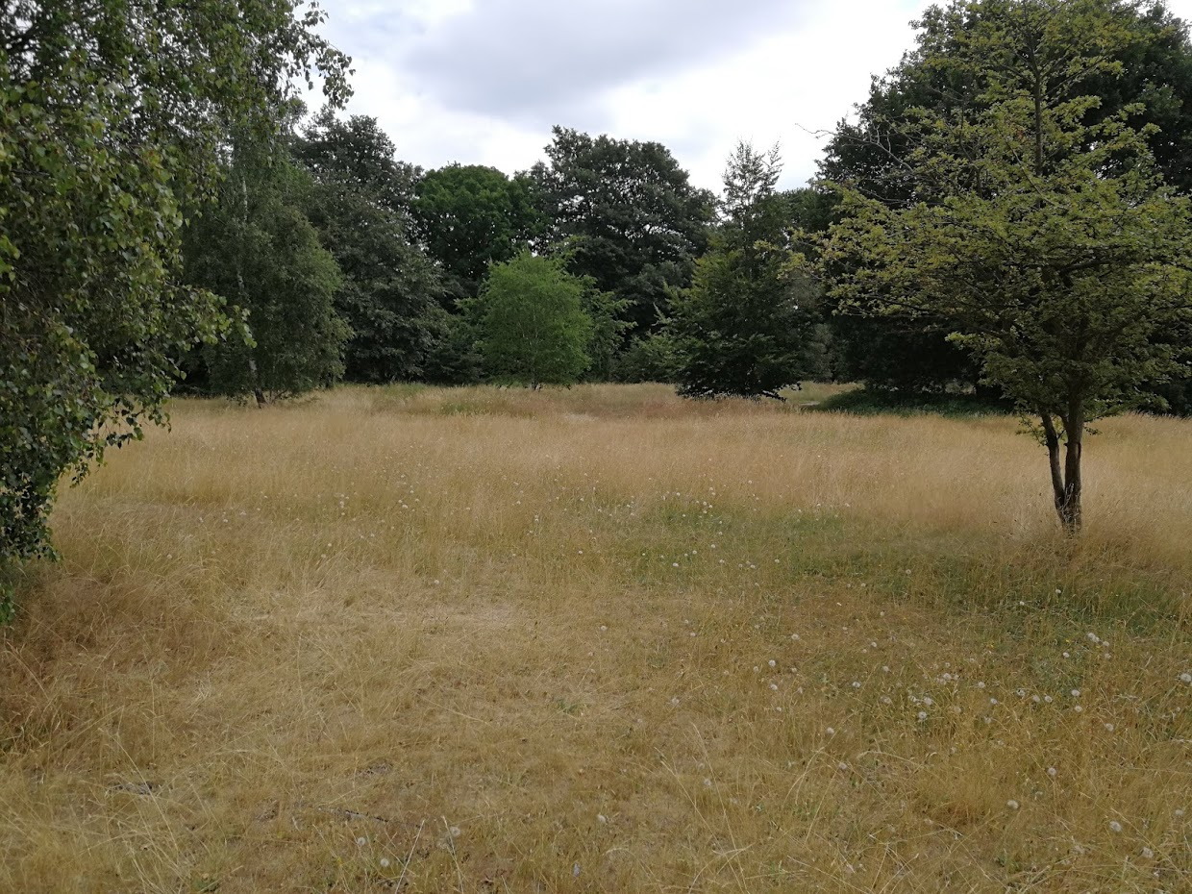
Chairman’s Report 2018
Beast from the east, March
“Savannah” on Tooting Common, July

Slide 2
Chairman’s Report
Membership
1,314 households
Net increase of 40
New members’ day
Events
RHS Wisley
Wildlife Gardening Fair
Need someone to take on public engagement / events
Field trips
47 planned in 2018
See all of Surrey’s 41 butterfly species
Transects & WCBS
~115 (105 last year)
Heaths, inner London
Annual Report
Hard copies - suggest £3 donation
BC’s 50th Anniversary
Day of action at Barnes Common
Other conservation work parties
Moths
Conservation work
Surveys and monitoring
Partners
London:
Big City Butterflies

Slide 3
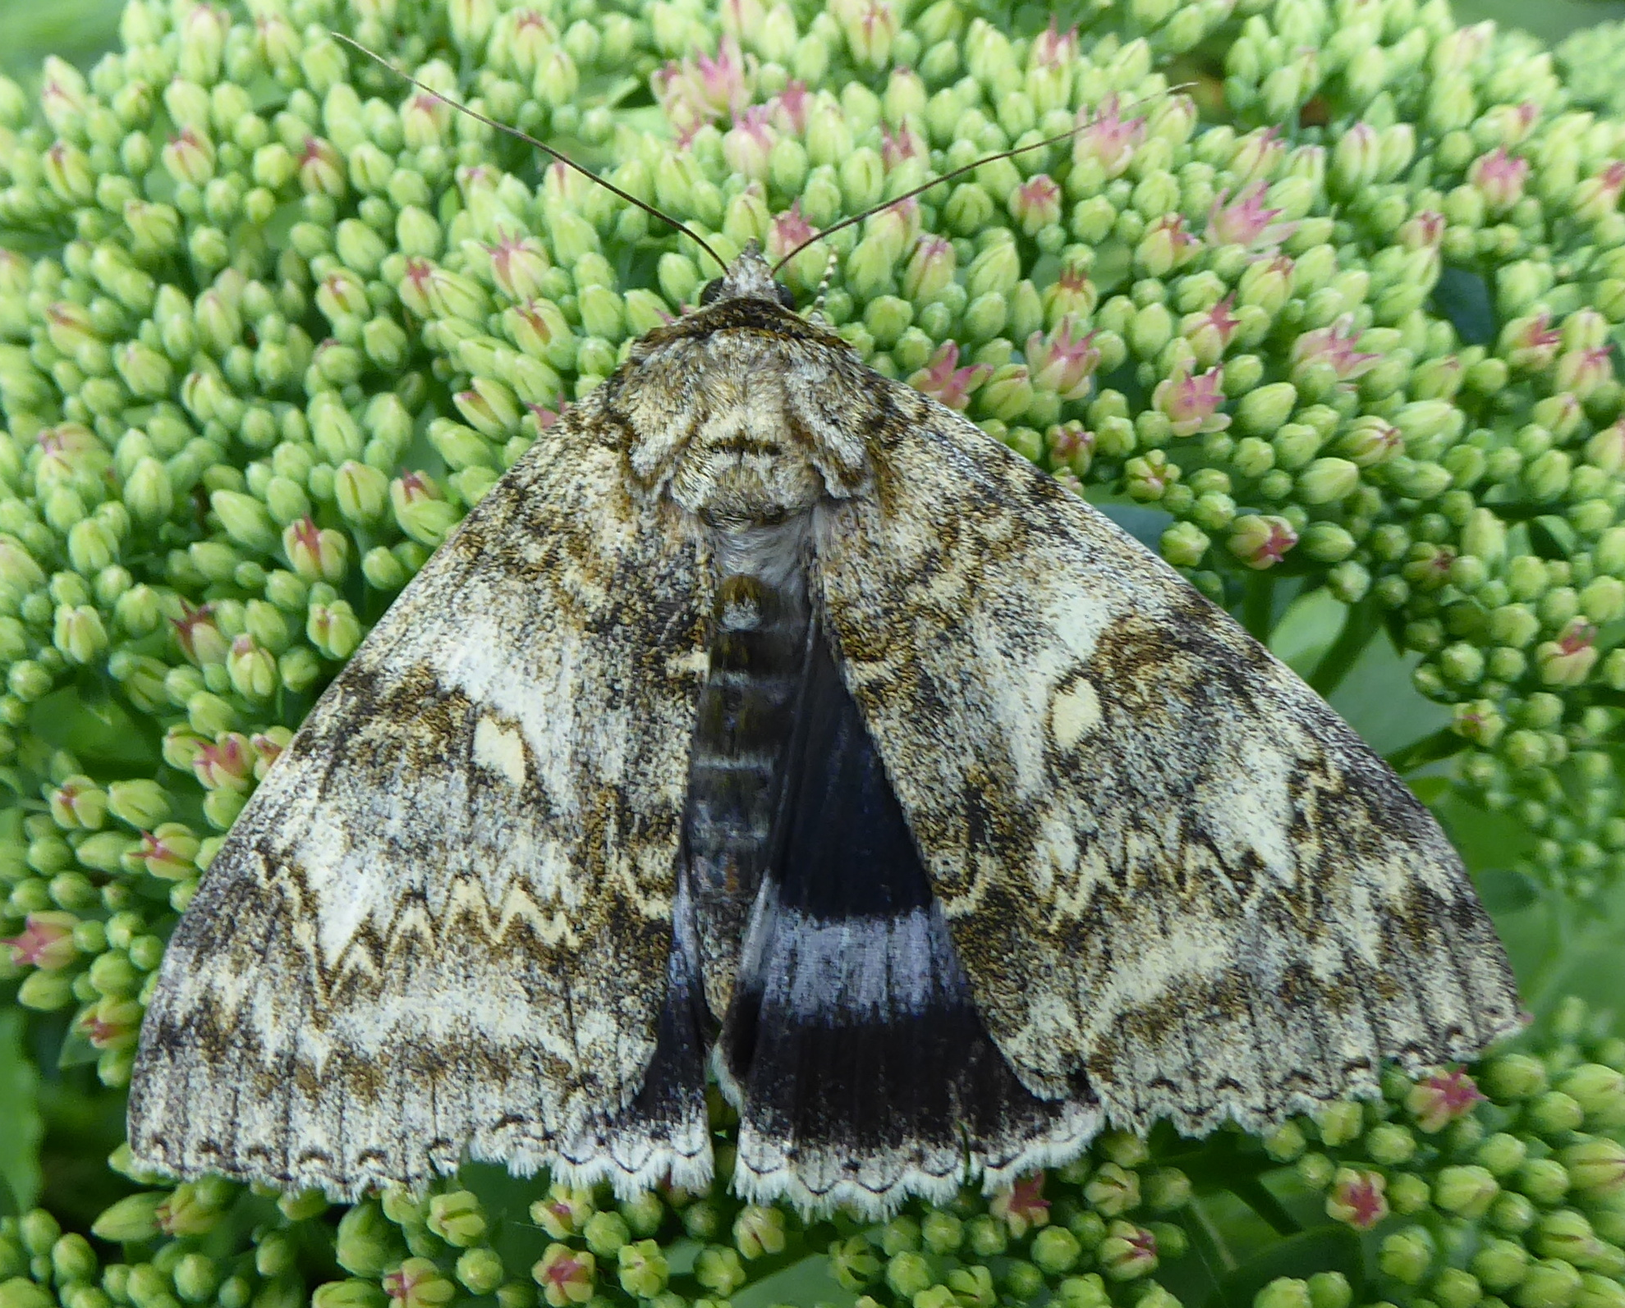
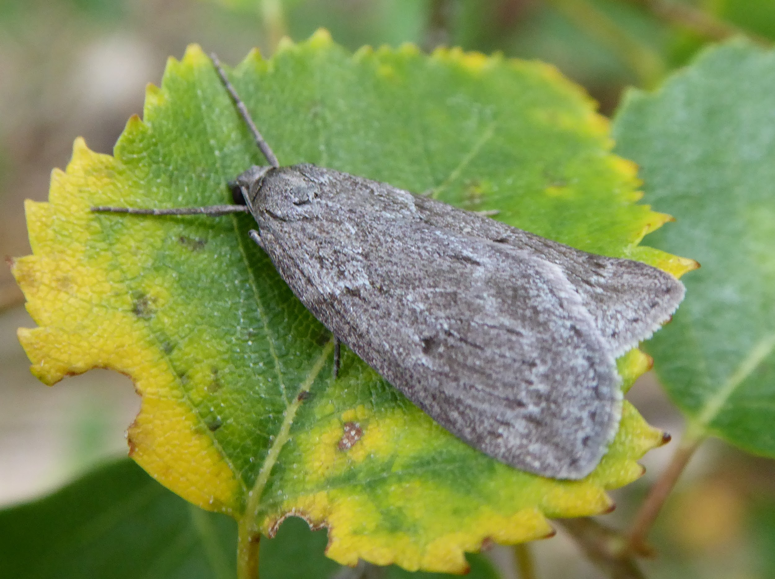
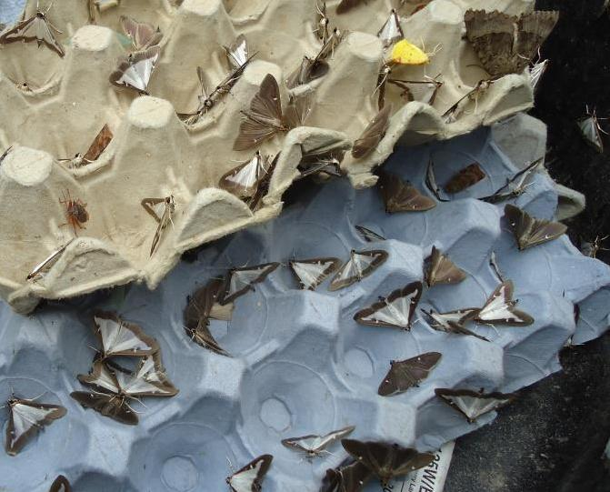
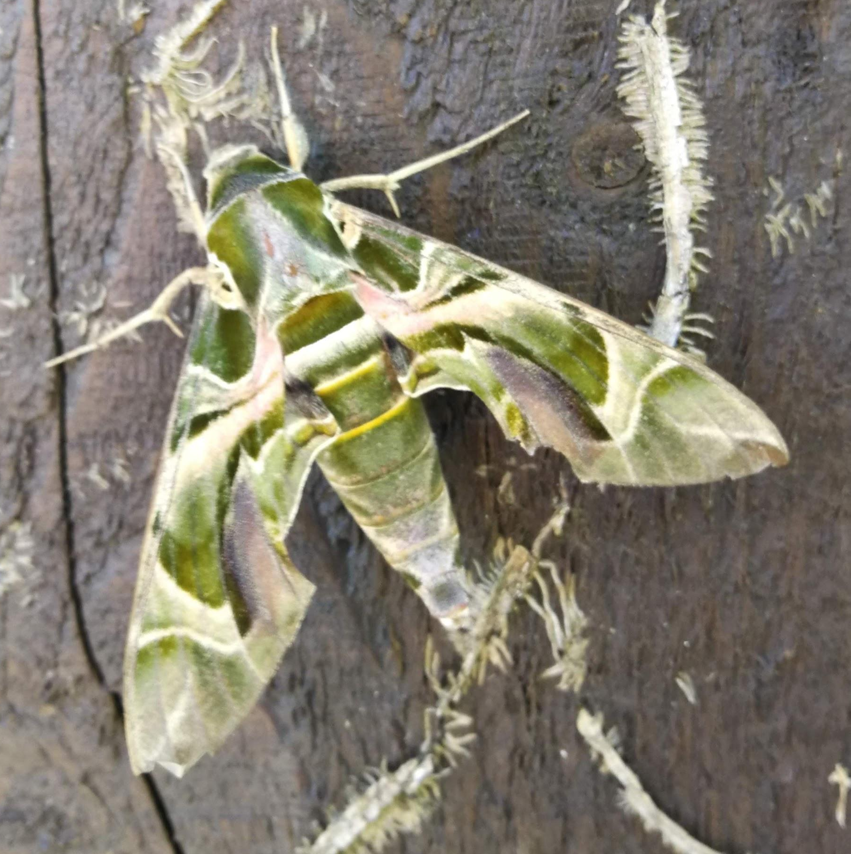
Moths
Heart Moth
Straw Belle
Betony Case-bearer
Jersey Tiger
Gypsy Moth
Oak Processionary
Get involved
Garden Moth Scheme
Surrey moths group
Clifden Non-pareil
Horse Chestnut
Box Tree Moth
Oleander Hawk Moth

Slide 4
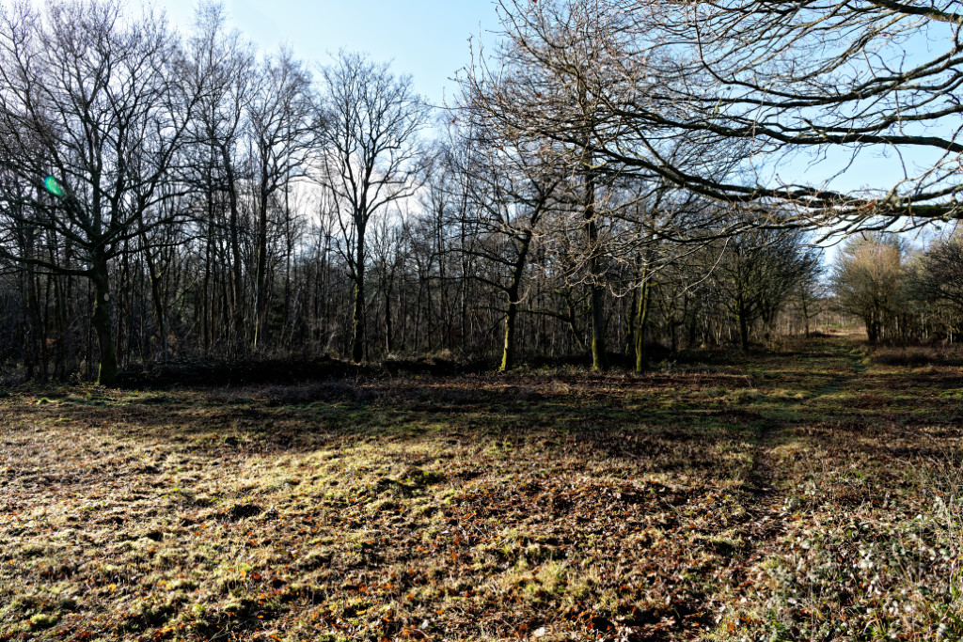
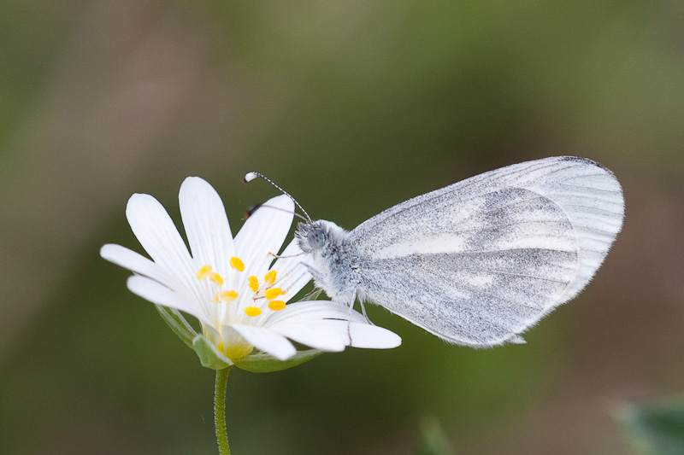
Conservation work
Small Blue “Stepping Stones” project
Fiona Haynes
Oaken Wood Reserve, Chiddingfold
Peter Beale 1929 - 2018
Record numbers of Wood White this year
Also, Broad-bordered Bee Hawk-moth, Drab Looper, Betony Case-bearer (larvae)
More work parties for ride clearance etc: Nov 6, Dec 6, Jan 3, Feb 7, Mar 7
Discussing larger project in the area

Slide 5
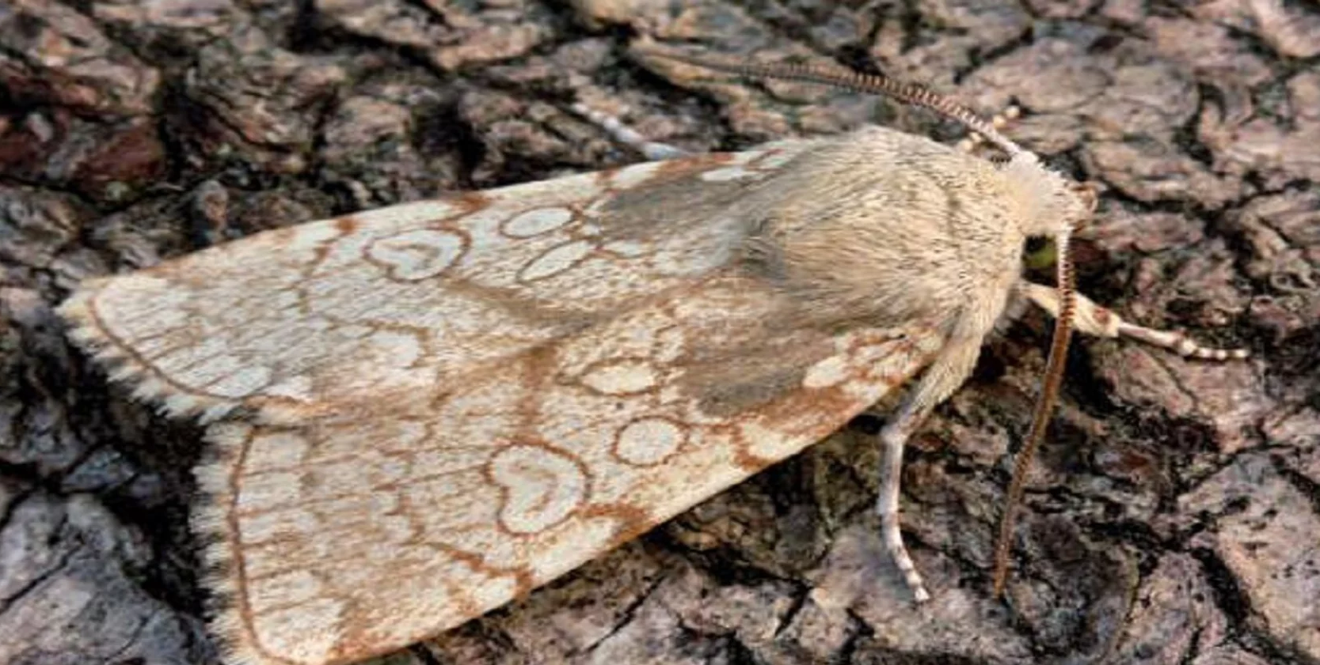
Surveys and monitoring
White-letter Hairstreak
Brown Hairstreak
Grayling
Silver-studded Blue
iRecord
Big Butterfly Count
Heart Moth
White-letter Hairstreak known distribution, 2016-18

Slide 6
Working with partners
National Trust, e.g. Small Blue project
Surrey Wildlife Trust, e.g. Small Blue project
London Wildlife Trust, e.g. their Great North Wood project
Forestry Commission, e.g. Oaken Wood
Borough Ecology Officers - London project
TCV - Stave Hill transect (Rotherhithe)
Amphibian and Reptile Conservation Trust
Academia
Exeter University 9-year national survey of Silver-spotted Skipper
MSc research into Silver-studded Blue on Chobham Common
PhD research into Grizzled Skipper on the North Downs
… plus many others, e.g. landowners, Pewley volunteers, Gatwick Greenspace etc

Slide 7
London project - Big City Butterflies
Successful application to HLF for Stage 1 development funding
Jan-Dec 2019
Now recruiting Development Officer
If successful, followed by 4-year project
Focus on Inner London - 4 branches
Partner with London Boroughs, London Wildlife Trust, GiGL, etc
Build new contacts, profile, membership, partnerships in the capital
#NatureUnderOurNoses
Habitat Management
Surveying & Monitoring
Engagement

Slide 8
Thank you for your support
Volunteers
Transect and Wider Countryside Butterfly Survey walkers
Surveyors - Brown Hairstreak, White-letter Hairstreak (+ elms), etc
Everyone who submits records
Moth-ers
Our many partners
Donors
Head Office staff
Committee members
Branch members
We couldn’t do it without your help!

